Slide 1
MSE 311: Thermodynamics of Materials
Lecture 17: Phase diagram-III
Weishu Liu
Department of Materials Science and Engineering
Southern University of Science and Technology (SUSTech)
Email: liuws@sustech.edu.cn
Office: North Tower,Rm310

Slide 2
46. Formation of a new compound
Chapter 13.6
Binary system contanning compounds
Ref. Introduction to the thermodynamics of Materials, 6th edition, D. R. Gaskell, and D. E. Laughlin

Slide 3
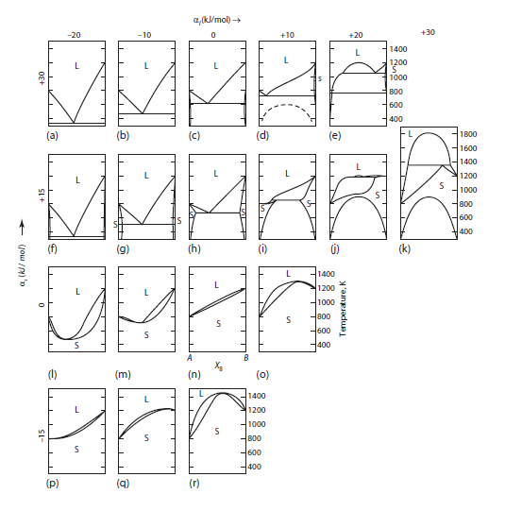
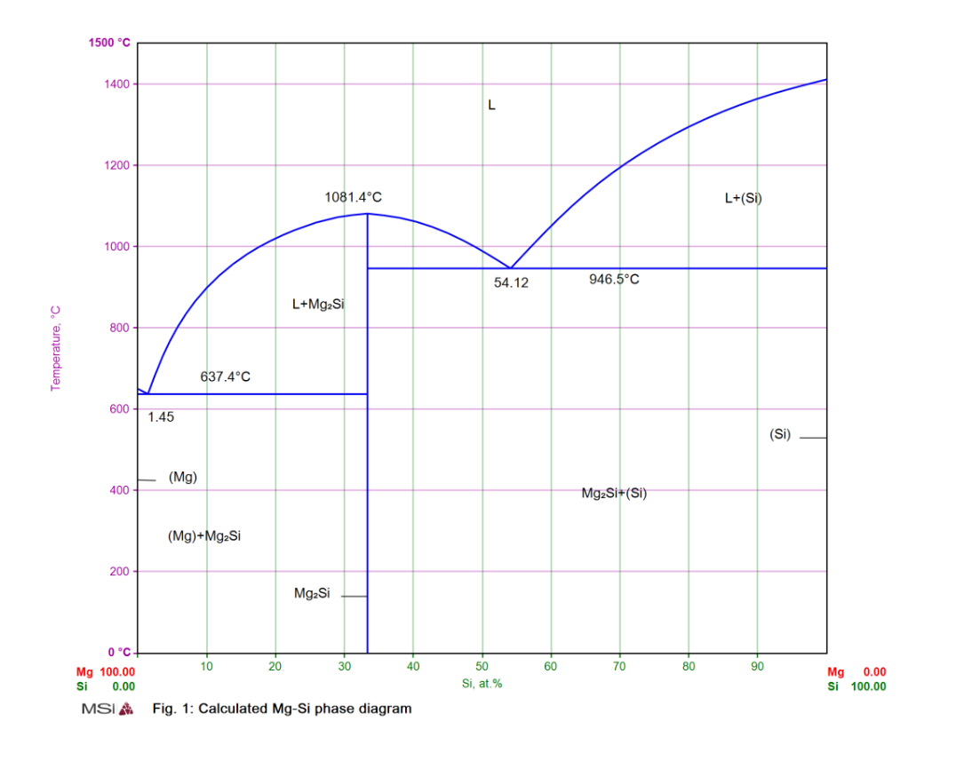
Binary phase diagram contains a compound
Mg-Si phase diagram

Slide 4
AB new phase
(A,B )
Solid solution
A/B
Phase separate
-2RT
Ω_{AB} =0
2RT
Equation of binodal curve
Equation of sipnodal curve

Slide 5
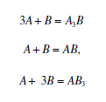

Slide 6
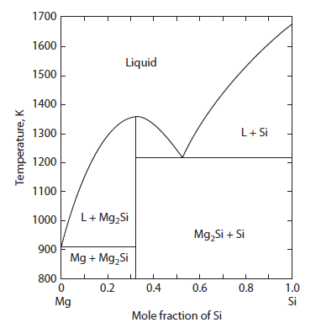

The calculation of the Mg-Si phase diagram
The phase diagram for the system Mg– Si is shown in Fig. 13.14. Determine the extent to which the phase diagram can be calculated, assuming that the liquid solutions exhibit regular solution behavior
Magnesium melts at 921 K:
Silicon melts at 1688K;
Mg₂Si melts at 1358K;
The standard Gibbs free energy change for the reaction
Regular solution approximation

Slide 7
The calculation of the Mg-Si phase diagram
The equilibrium equation
(ii)
T=1358K
Since liquids on the Mg₂ Si liquidus line are saturated with Mg₂ Si, a_{Mg2Si ( s)} =1
Mg
Mg2Si
Si
Determined the interaction parameter Ω in the liquid solution

Slide 8
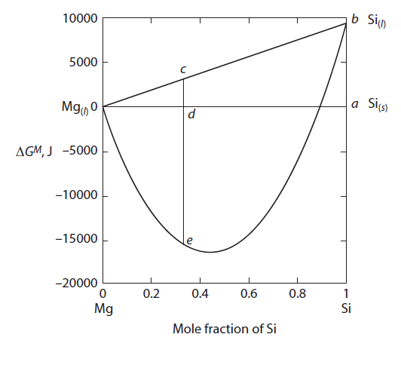
The calculation of the Mg-Si phase diagram
T=1358K: Liquid Mg + Solid Si
standard state
T=1358K
Gibbs energy of
mixing liquid Mg-Si
Mg
Mg2Si
Si
At=1358K, Liquid Mg + Solid Si as standard
Line cd:
The formation energy of Mg_{2/3} Si_{1/3} from Liquid Mg + Solid Si
Line ce:
Line de:

Slide 9
The calculation of the Mg-Si phase diagram
Line ce:
The formation energy of Mg_{2/3} Si_{1/3} liquid solution
from Liquid Mg + liquid Si, at T=1358K
* The interaction parameter Ω=-53,040 [J]
T=1358K
Mg
Mg2Si
Si

Slide 10
The calculation of the Mg-Si phase diagram
Mg₂ Si liquid line
(ii)
Since liquids on the Mg₂ Si liquidus line are saturated with Mg₂ Si, a_{Mg2Si ( s)} =1
Ω=-53,040
Regular solution approximation
T=1358K
Mg
Mg2Si
Si

Slide 11
The calculation of the Mg-Si phase diagram
Si liquid line
Since liquids on the Si liquidus line are saturated with Si, a _{Si ( s)} =1
T=1358K
Mg liquid line
Mg
Mg2Si
Since liquids on the Mg liquidus line are saturated with Mg, a _{Mg( s)} =1

Slide 12
47. Phase diagram of multi elements
微观组织热力学，西泽泰二，化学工业出版社
相图理论及其应用， 王崇琳，高等教育出版社

Slide 13
Phase diagram of multi elements
Single element two phase
two elements two phase
Three elements two phase
Phase I
Phase II
Phase α
Phase β
Phase α
Phase β

Slide 14
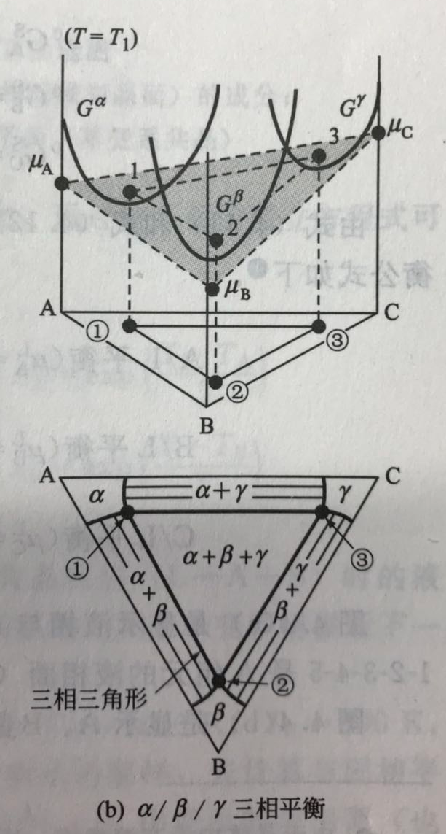
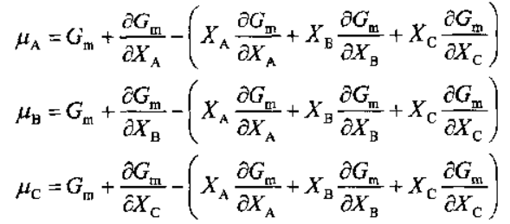
Phase diagram of multi elements
Three elements Three phase
Phase α
Phase β
Phase γ
For the system with n elements

Slide 15
Phase diagram of multi elements
Ternary element molar free energy:
General formula:

Slide 16
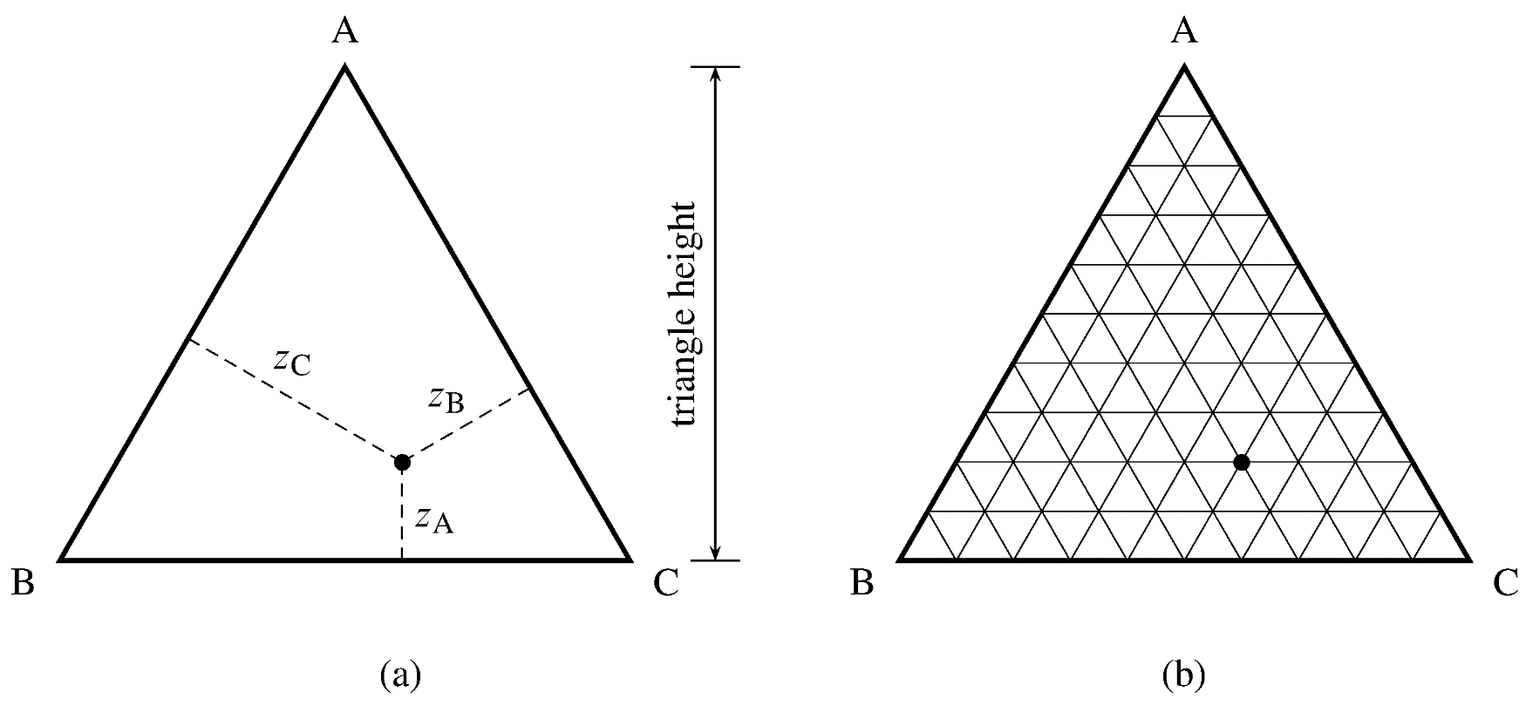
Composition triangle
Concentration triangle or Gibbs triangle
z_{A} + z_{B} + z_{C} =1
z_{A} =20%
z_{B} =30%
z_{C} =50%

Slide 17
Gibbs phase law in ternary system
f=C-P+2
平衡相区 | 相数P | p-T-x |  | T=const. or P=const.
 |  | f | 平衡特性 | f | 平衡特性
单相区 | 1 | 4 | 四变平衡 | 3 | 三变平衡
双相区 | 2 | 3 | 三变平衡 | 2 | 二变平衡
三相区 | 3 | 2 | 二变平衡 | 1 | 一变平衡
四相区 | 4 | 1 | 一变平衡 | 0 | 零变平衡
五相区 | 5 | 0 | 零变平衡 | - | -

Slide 18
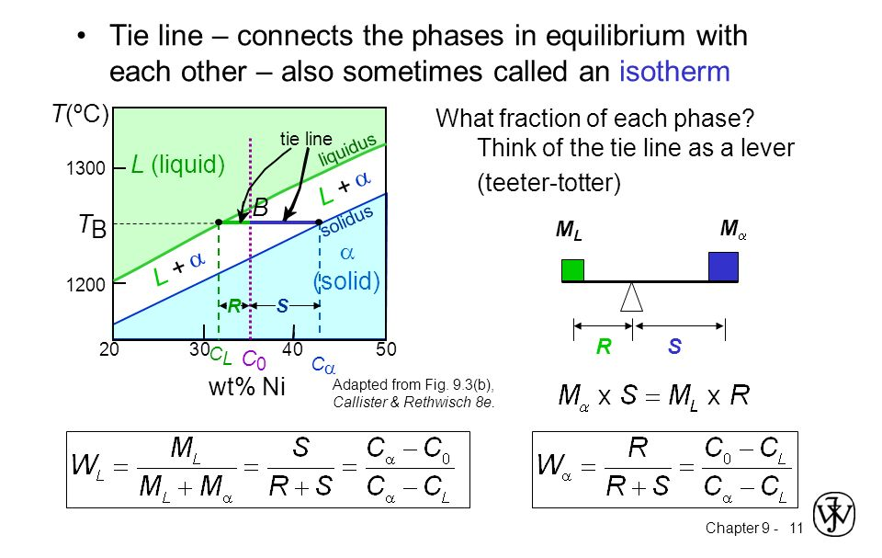
Tie line and Lever rule

Slide 19
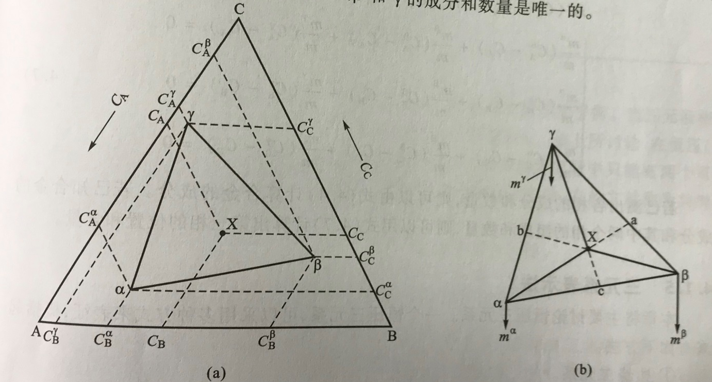
Tie triangle in ternary system
α, β, γ: new phases
Tie (结线)：

Slide 20
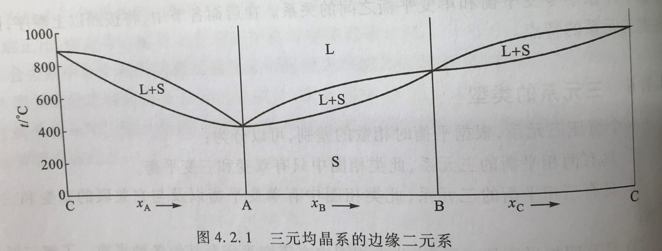
Ternary complete liquid and solid solutions
(三元均晶相图)
1. Binary boundary systems

Slide 21
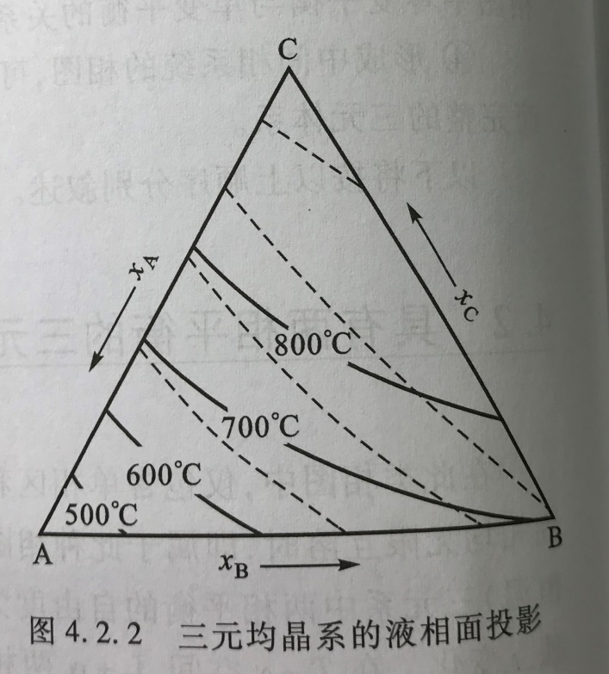
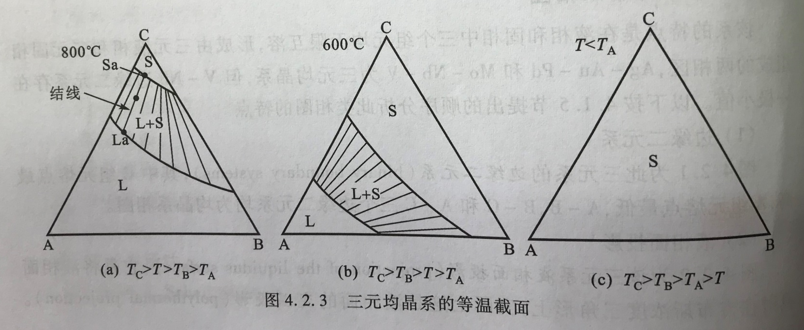
Isothermal section

Slide 22
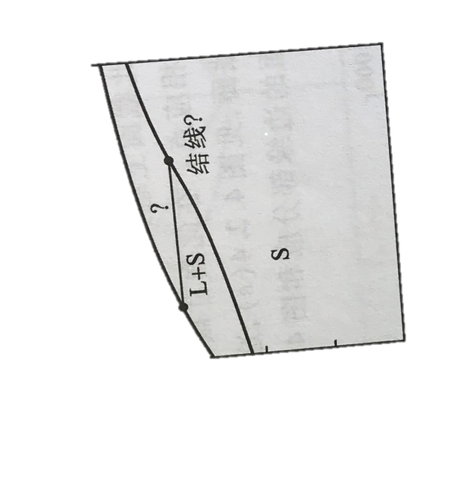
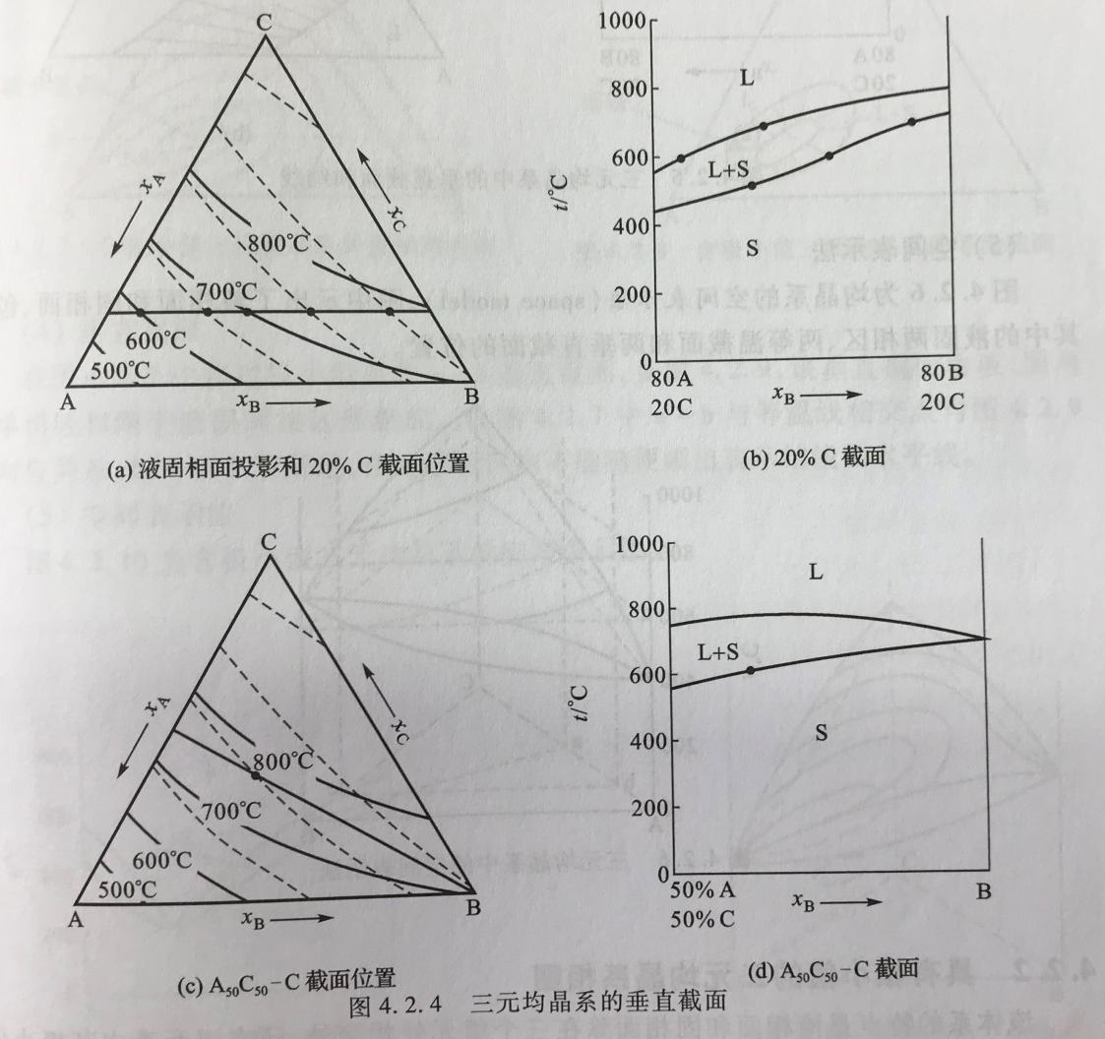
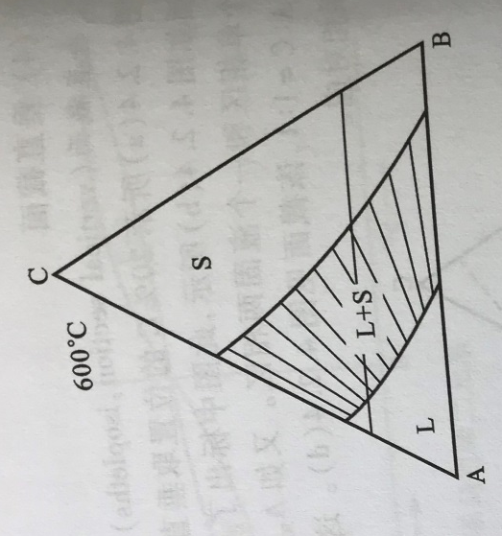
Vertical section
T/ ºC
80A
20C
80B
20C
注: 不能随便在垂直界面上标注表示结线的水平线

Slide 23
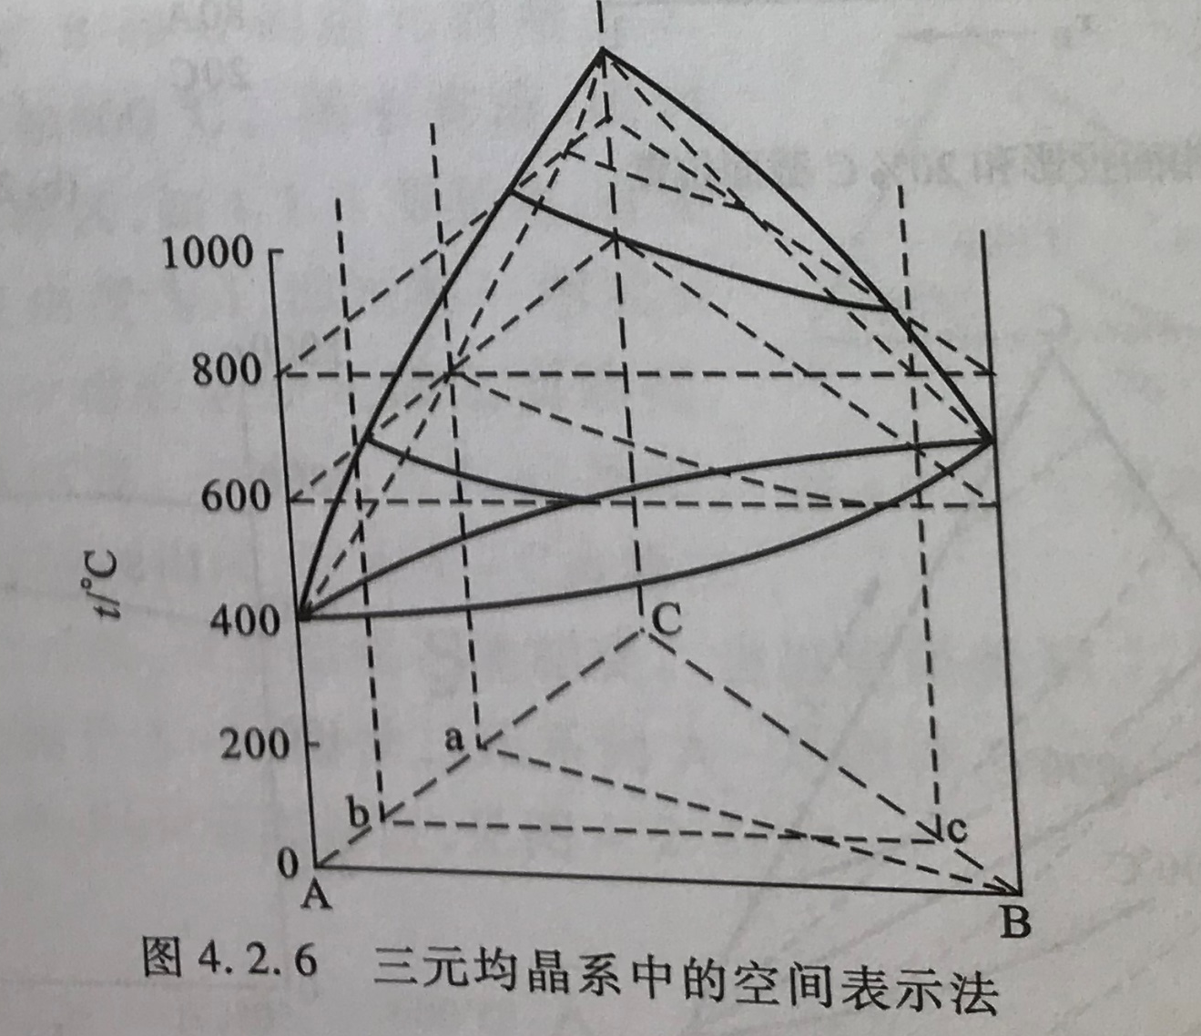
Space model

Slide 24
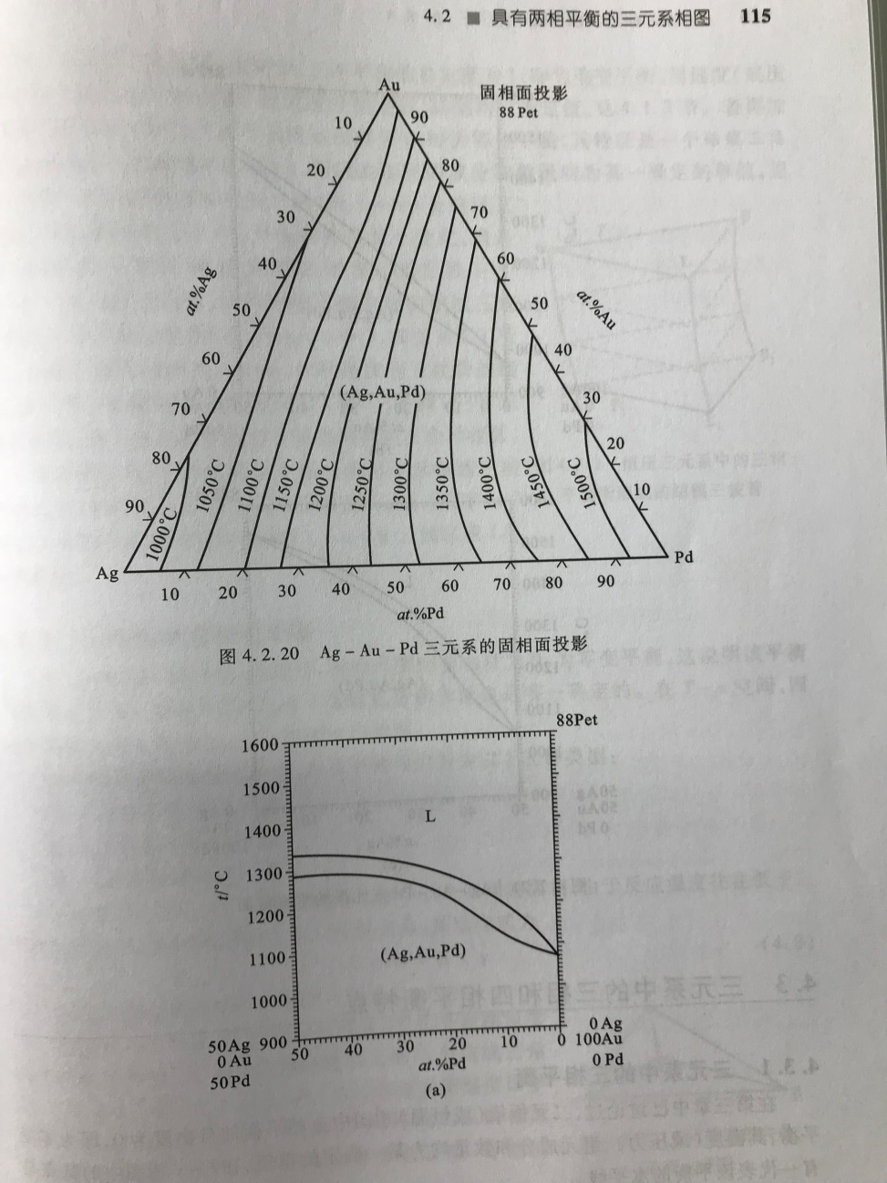
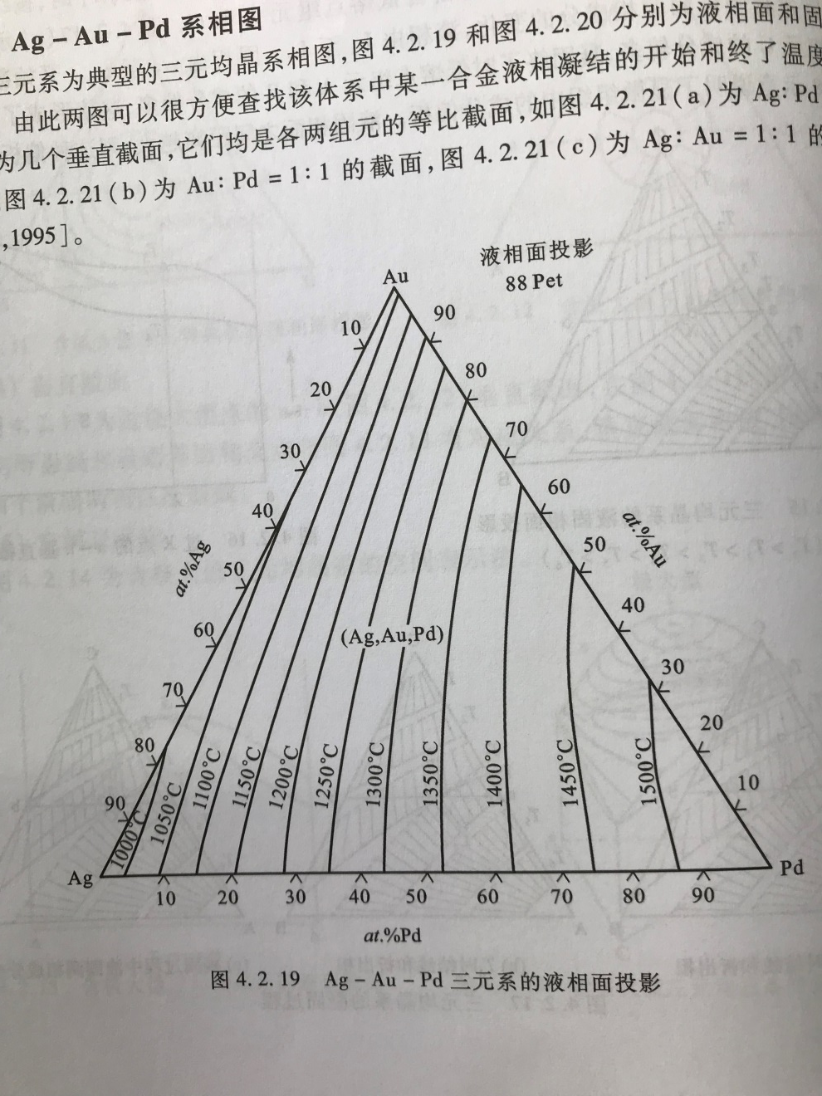
Ag-Au-Pd system

Slide 25
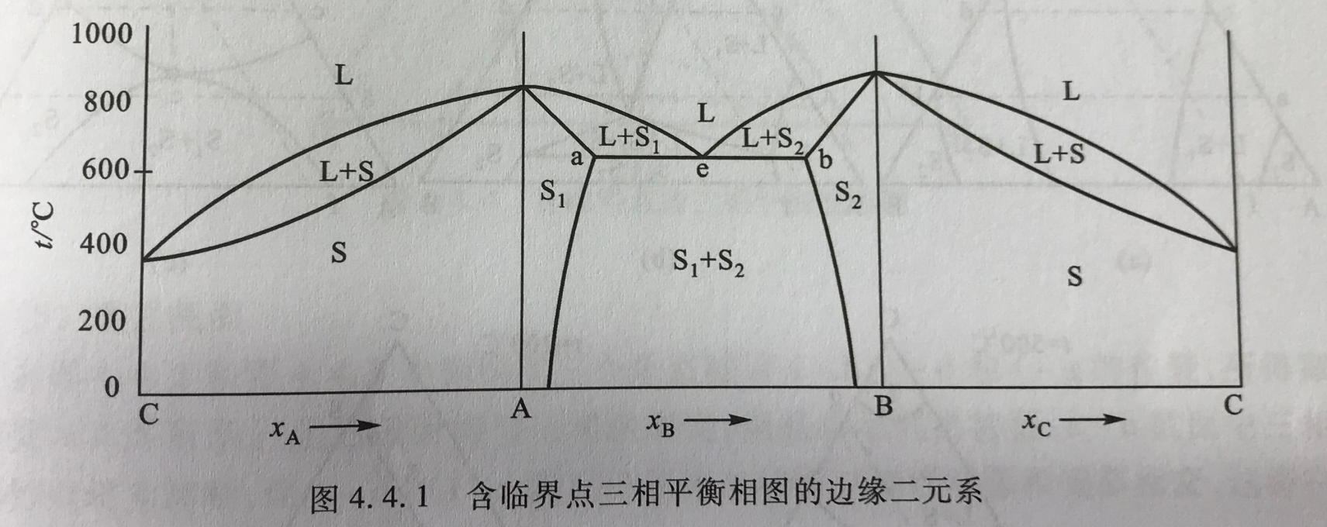
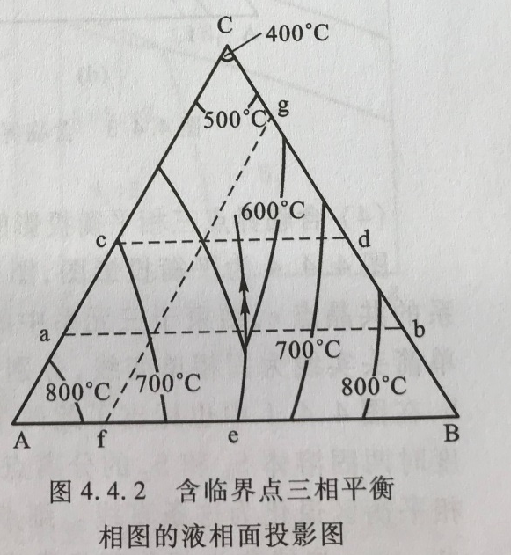
Ternary system with Eutectic point
Melting grooves ( 熔化沟)
Univariant line
Univariant valleys

Slide 26
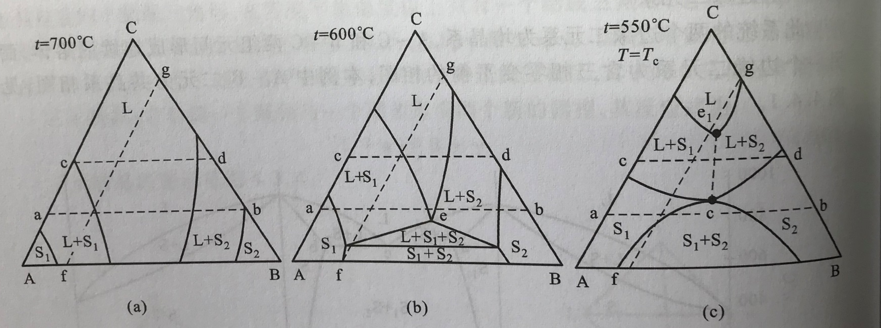
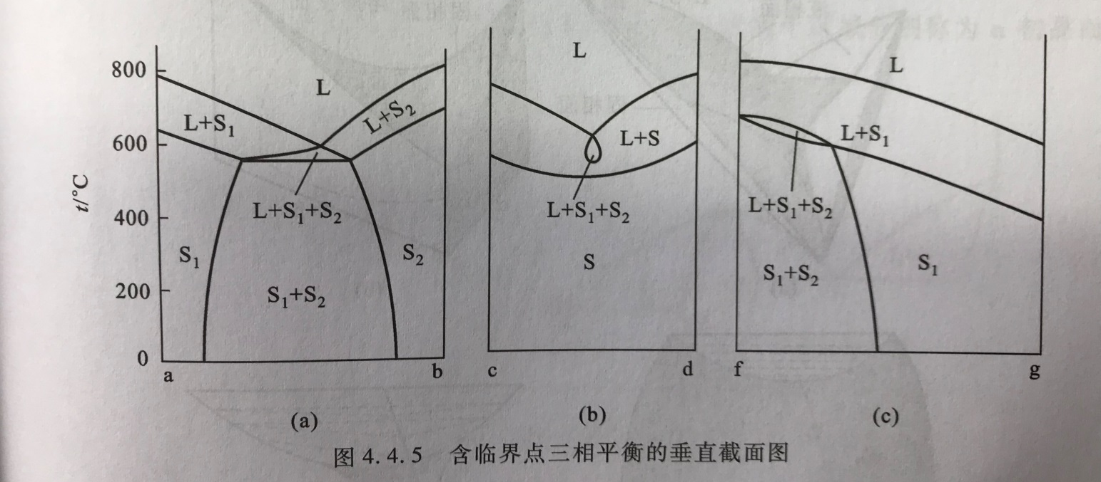
Ternary system with Eutectic point

Slide 27
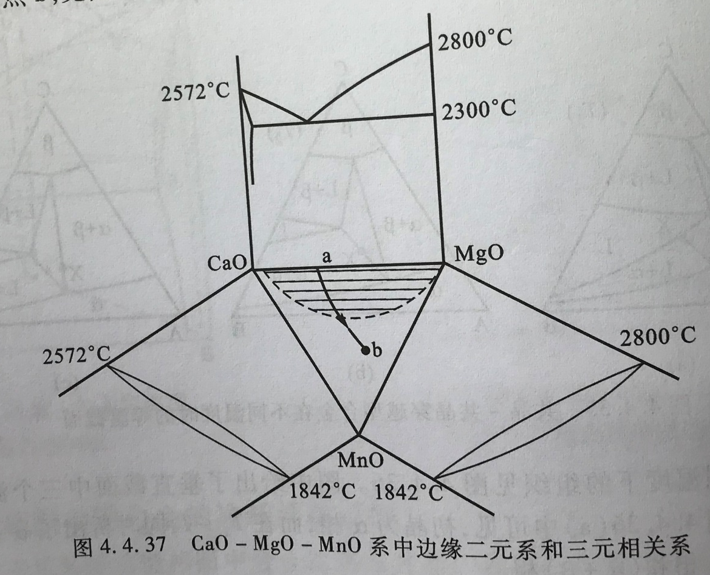
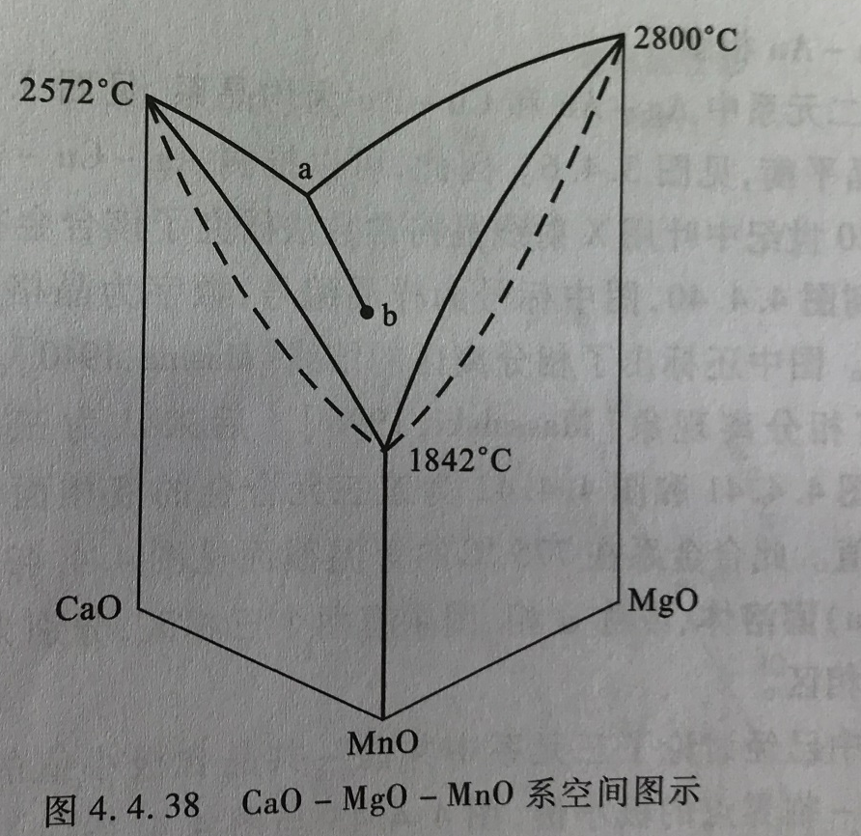
CaO-MgO-MnO

Slide 28
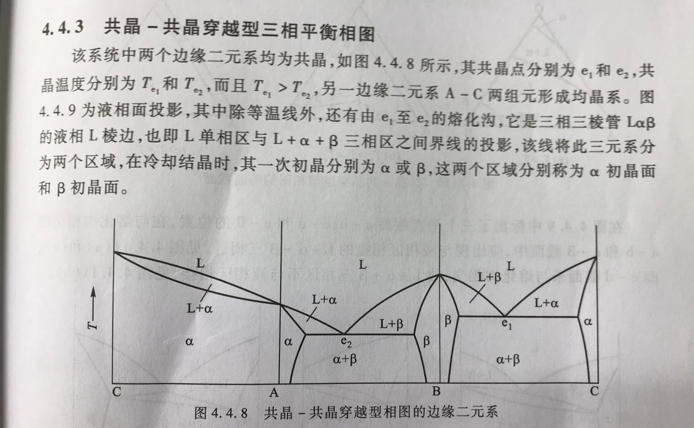
Ternary system with two Eutectic points

Slide 29
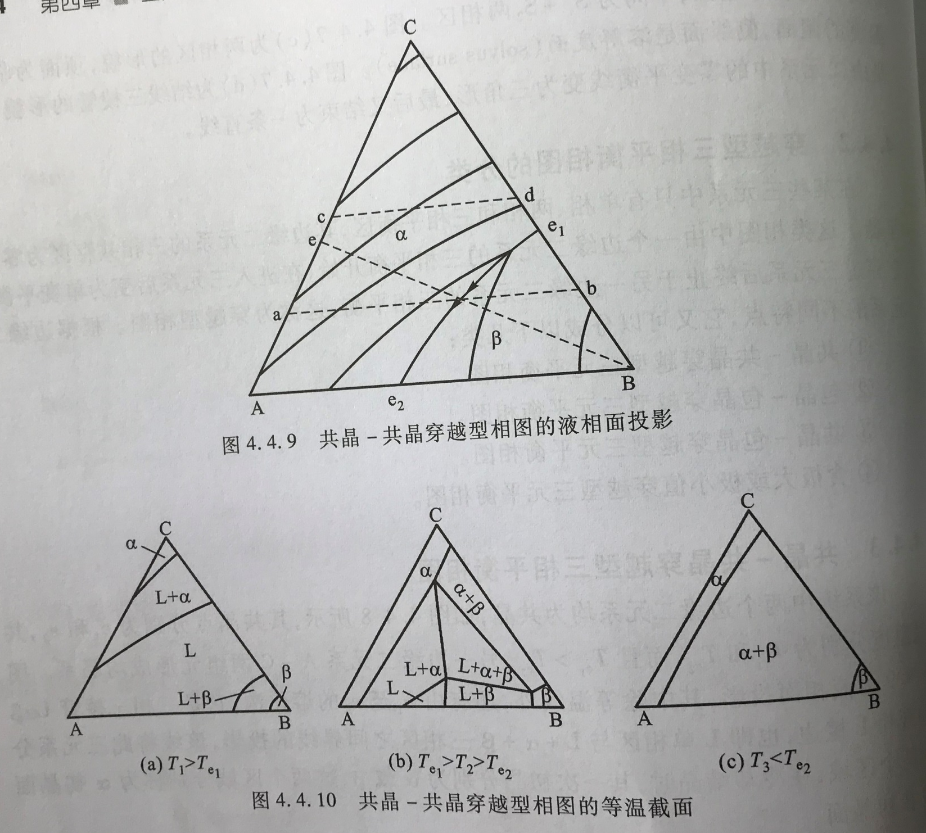

Slide 30
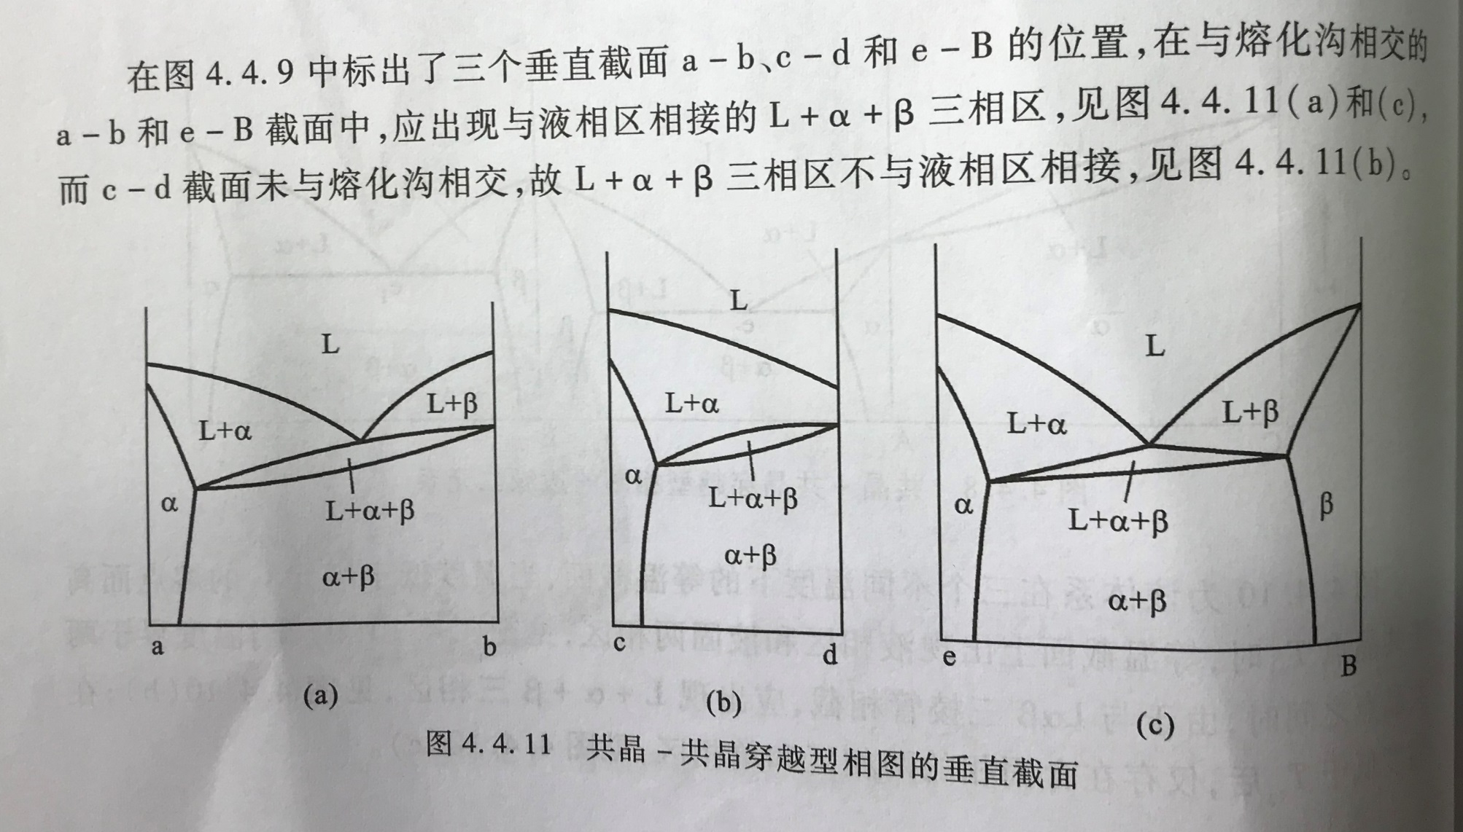
Ternary system with two Eutectic points

Slide 31
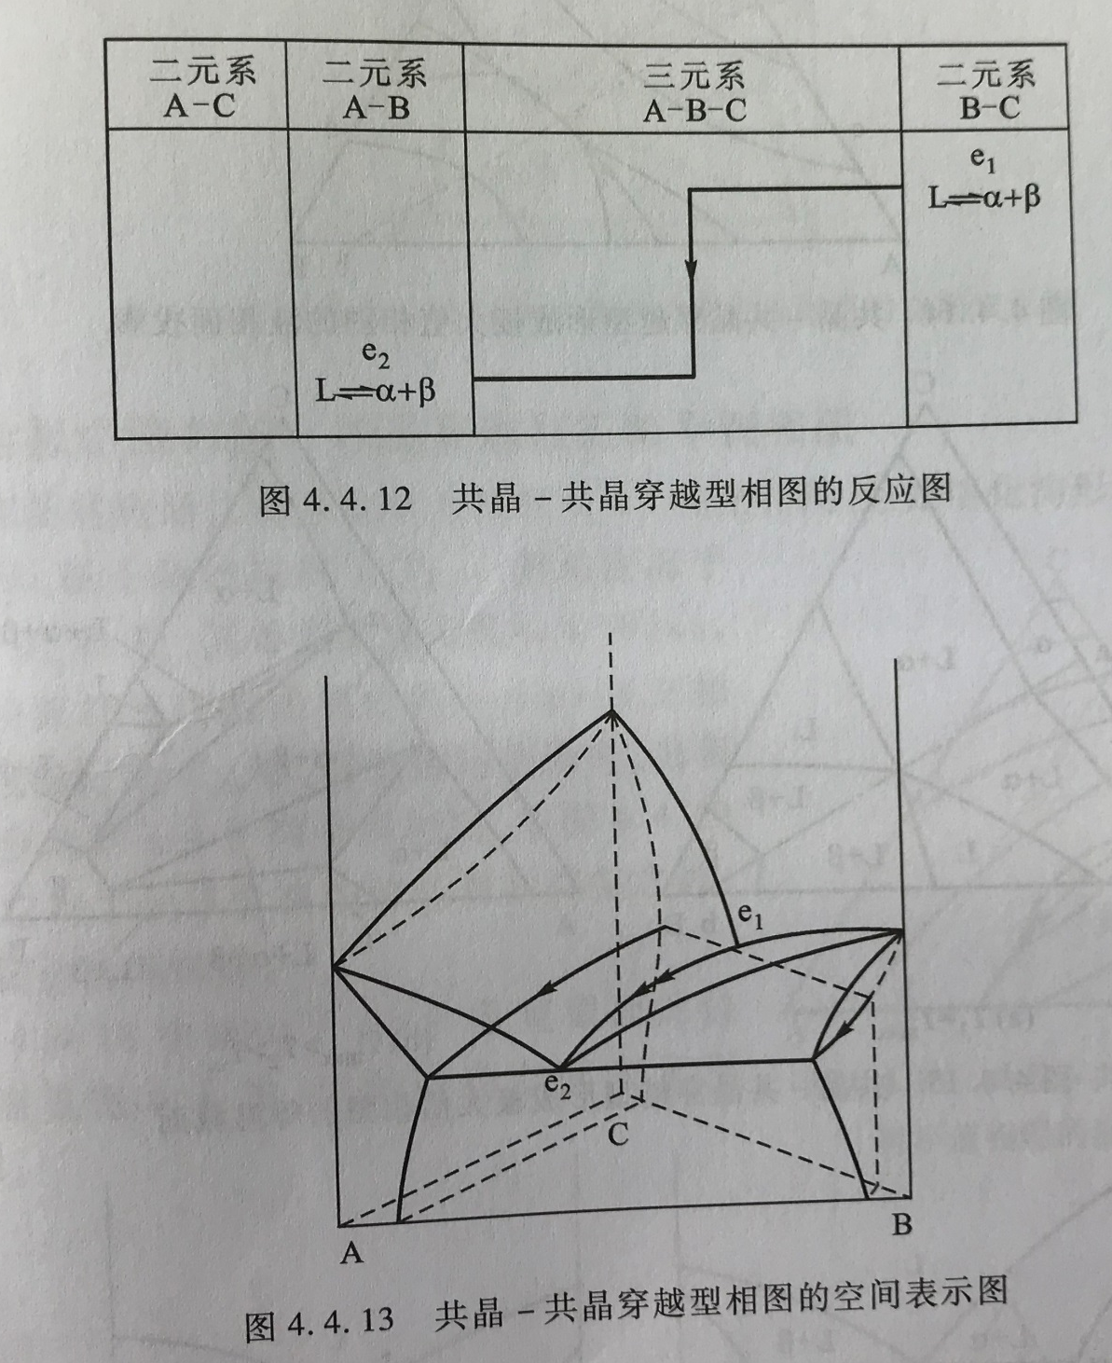

Slide 32
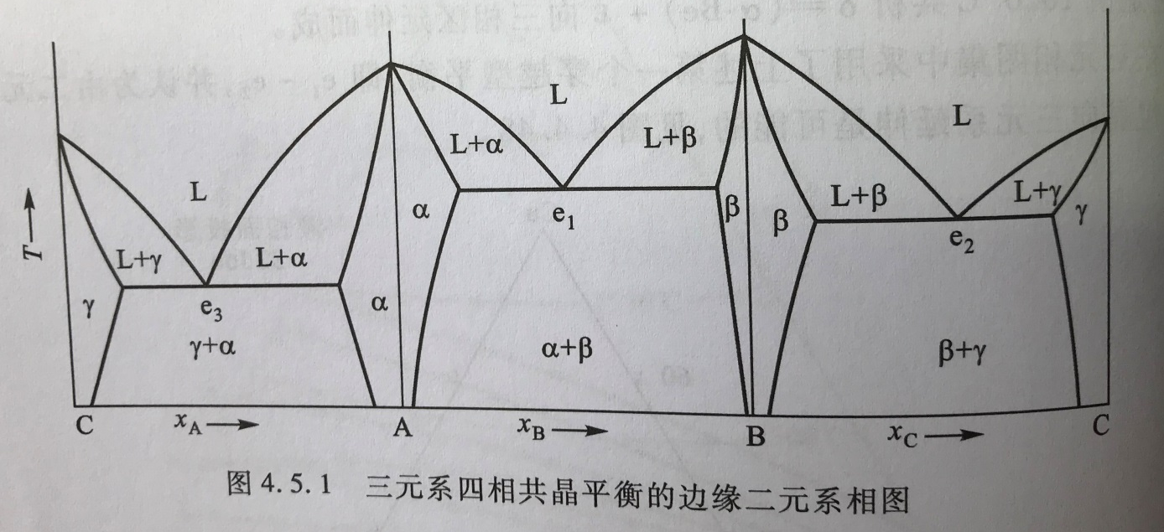
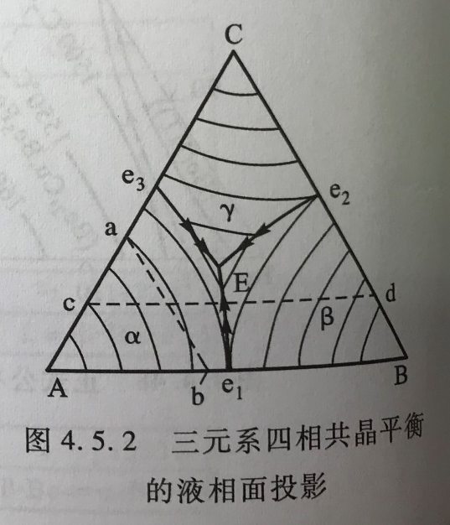
Ternary system with three Eutectic points
Binary boundary eutectic point: e1, e2, e3
Ternary four phase eutectic point: E
Eutectic line ( melting grooves) : e1E, e2E, e3E
Filed of primary crystallization

Slide 33
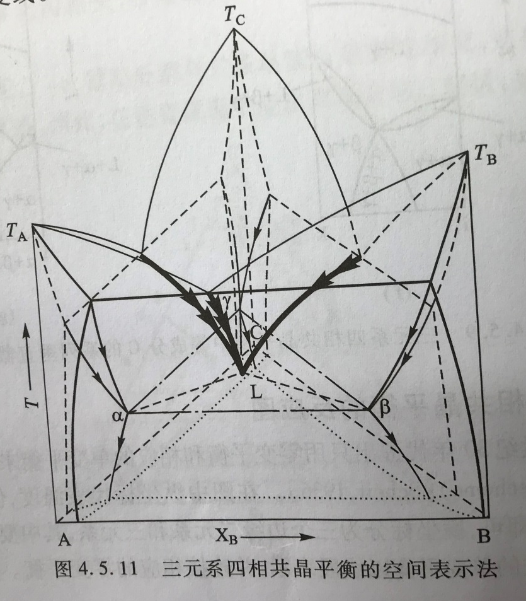
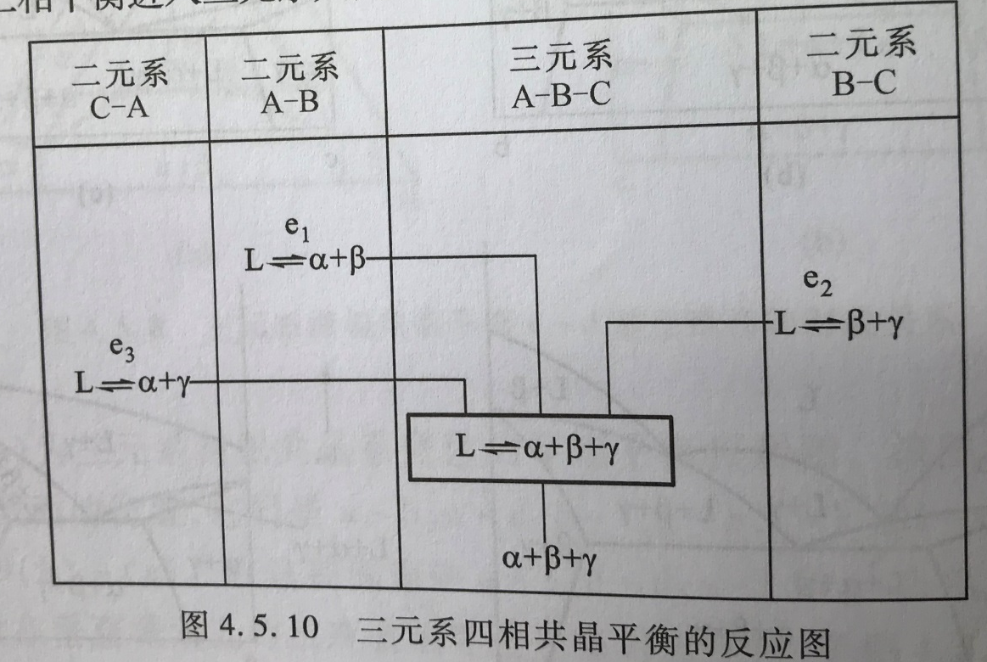
Ternary system with three Eutectic points
Reaction scheme is introduced by E. Scheil 1936.
利用零变平衡和相应的单变平衡来表示相平衡关系

Slide 34
L
L+β
L+α
α
α
α+ β
γ
L
α
β
4-phase region: L+α+β+γ

Slide 35
48. General Rule of Phase diagram
微观组织热力学，西泽泰二，化学工业出版社
相图理论及其应用， 王崇琳，高等教育出版社

Slide 36
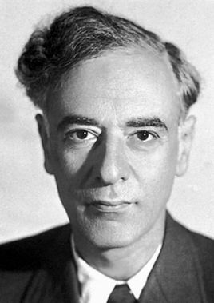
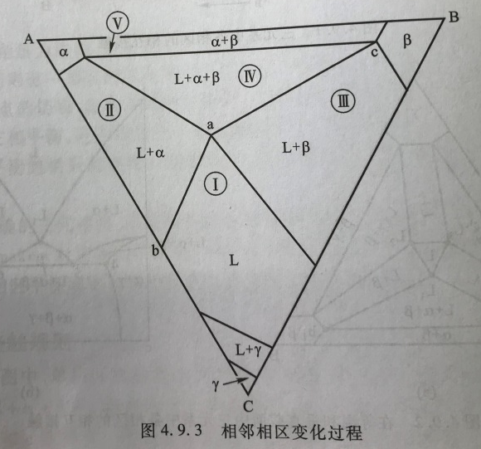
Landau phase boundary relationship
R₁ ： dimension of the phase boundary (相邻相界维数)，
eg. R₁ =2 for area ； R₁ =1 for line; ； R₁ =0 for point
R: dimension of phase diagram or section
D⁻ ： phase decrease across the boundary
D⁺ ： phase increase crease across the boundary
Lev D. Landau，
1908-1968
Region I→ Region II, increase a phase：
D⁺=1, R=2, R₁=1
Region IV→ Region II, decrease a phase
D⁻=1, R=2, R₁=1
Region I→ Region IV, increase two phase ：
D⁺=2, R=2, R₁=0
R=2

Slide 37
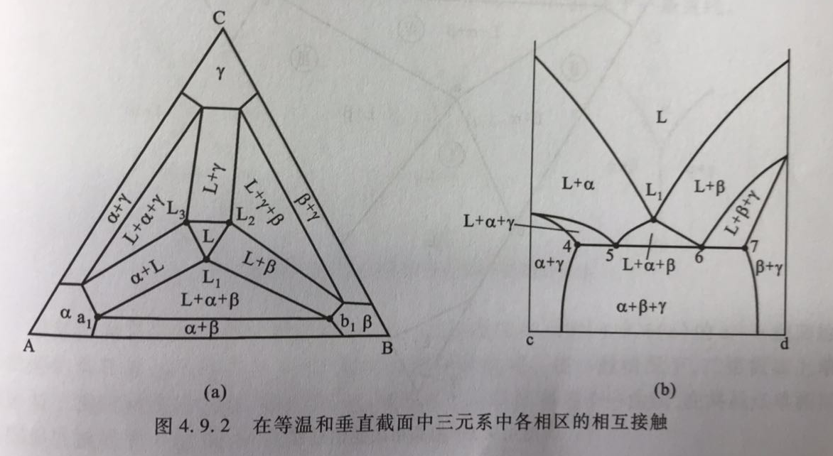
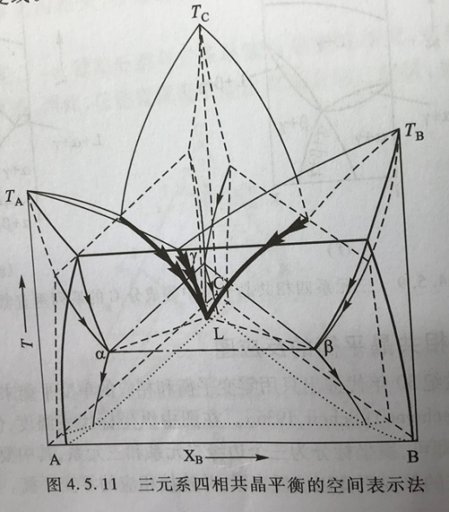
General rule of ternary phase diagram
single phase (f=3):
It connected with 4-phase region at a point，
eg. L and L+α+β+γ connected at L ; α and L+α+β+γ connected at a
It connected with 3-phase region at a line，
eg. L and L+ α+β connected at e1L melting grooves
It connected with 2-phase region at a area
eg. L and L+ α connected at a area
It connected with 1-phase region at pole

Slide 38
General rule of ternary phase diagram
two phase region (f=2):
It connected with 4-phase region at line，
eg. α+β and L+α+β+γ connected at a-b line
It connected with 3-phase region at area，
It connected with 2-phase region at a curve
e.g. α+β and α+γ

Slide 39
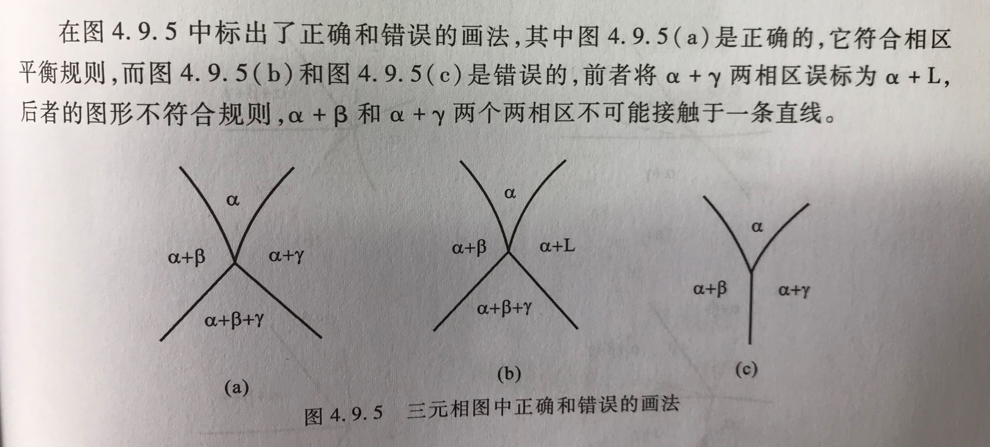
Landau phase boundary relationship

Slide 40
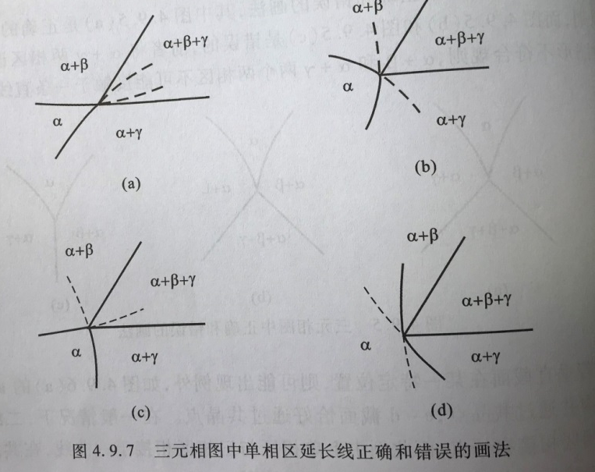
Extension line rule
1915年 Schreinmakers 从热力学上证明延长线法则
1940年1944年， Lipon和Wilson 分别从相平衡角度证明该法则
The extension line of boundary of the single phase
can enters 3-phase region，or two other two 2phase region
can’t enters another 1-phase region or one 3-phase region + one 2-phase region
The included angle (夹角) of extension lines of boundary of the single phase
should be less than 180 º

